Slide 1
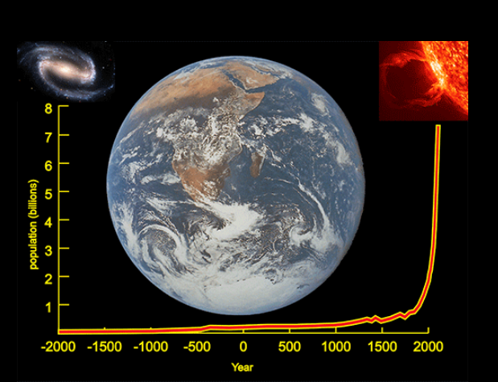
ENV 1110: Introduction to Environmental Problems
Titles should be at 18 points
Author
Affiliation
Date
Thesis statement or project motivation should be clear, compelling, and prominent. Take a position and defend it. Follow the guidelines on Kanat (2020a).
The Problem
Notes:
Text should be no less than 16 points.
Adjust the size of the boxes as appropriate.
Use three or four boxes for text.
Be sure to include references and acknowledgements.
Use very high resolution images and figures.
Use three-part figure caption and be sure to refer to each figure in the text.
Use at least four data-rich, informative figures.
Use emboldened or underlined subheadings.
Tap ‘F7’ to spell check the file.
To add more text boxes, click: insert > text box.
This page is setup to be
1248 pixels wide by 2880 pixels tall.
Do not change the width of this page, but you can change the height.
More details about the problem
Figure 1. World Population (Kanat 2020b)
The solution, or actions one can take
References
Kanat, L. (2020a). Introduction to Environmental Problems. Retrieved on 20 Mar 2020 from http://kanat.nvu.vsc.edu/env1110/e1110sum.htm
Kanat, L. (2020b). Kanat at NVUJ. Retrieved on 20 Mar 2020 from http://kanat.jsc.vsc.edu/default.htm
Acknowledgements
Acknowledge those who helped you.

