Slide 1
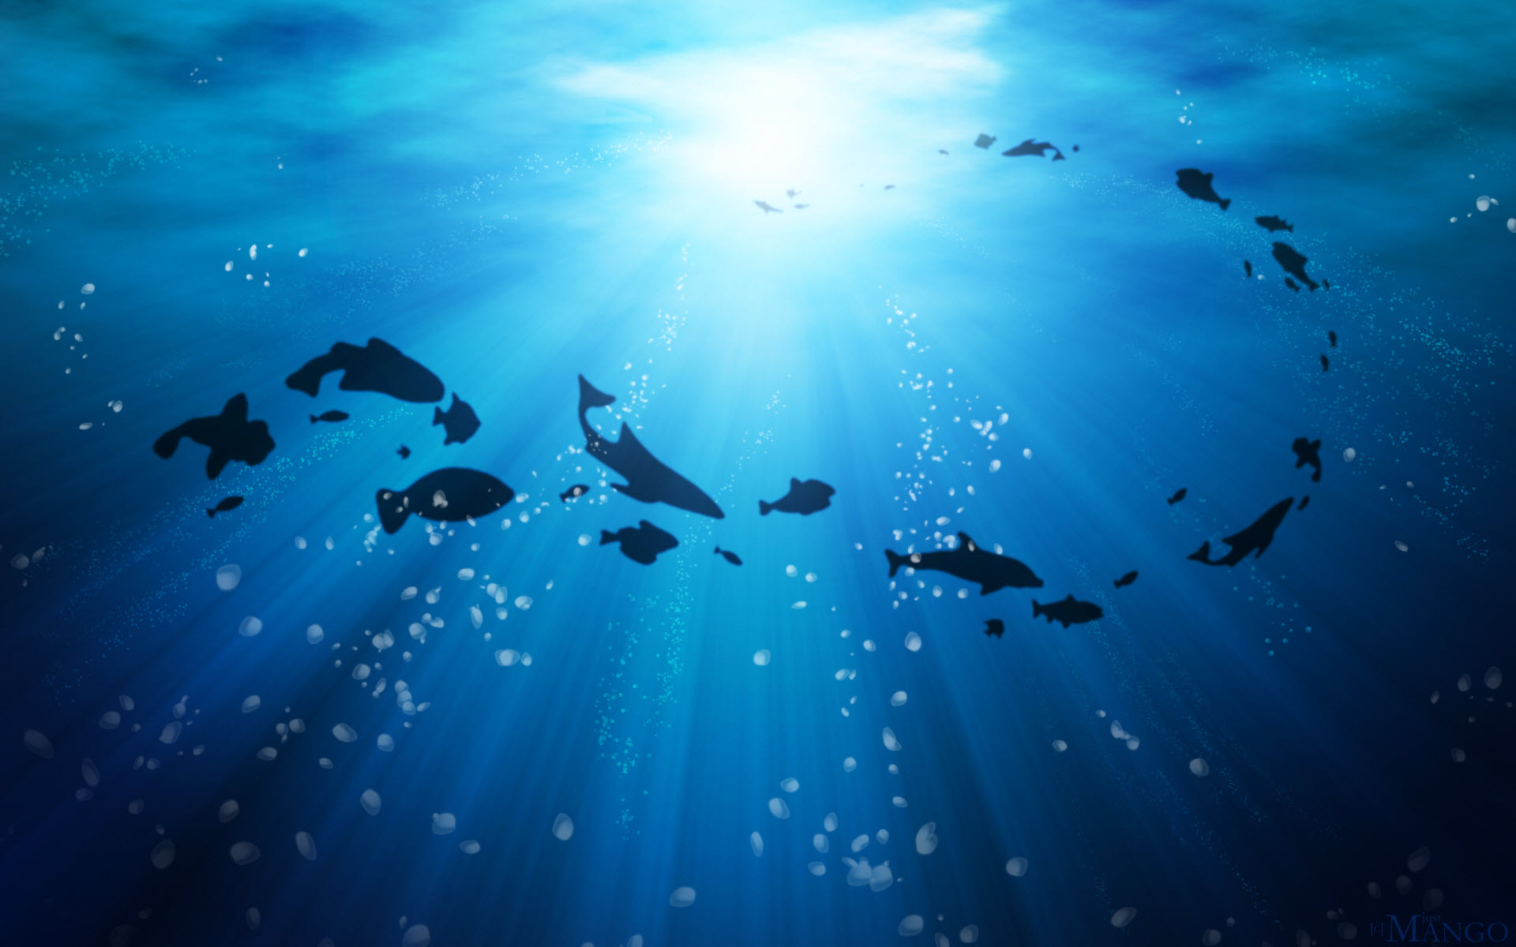
Fishing For The Future
Joseph J. Grzyb
Johnson State College
ENV 4730
April 17, 2014
(Wallpaperswa, 2012)

Slide 2

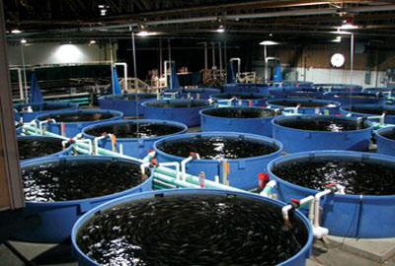
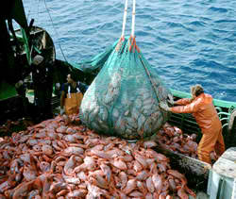
As the world’s population grows, traditional methods of fishing cannot meet the world’s demand for seafood. Aquaculture and aquaponics are the solutions
9 Billion?
Open Water Fishing
11 Billion?
(Local Ocean Fish Farm, 2010)
(People, 2011)
(World Wildlife Fund, 2006)

Slide 3
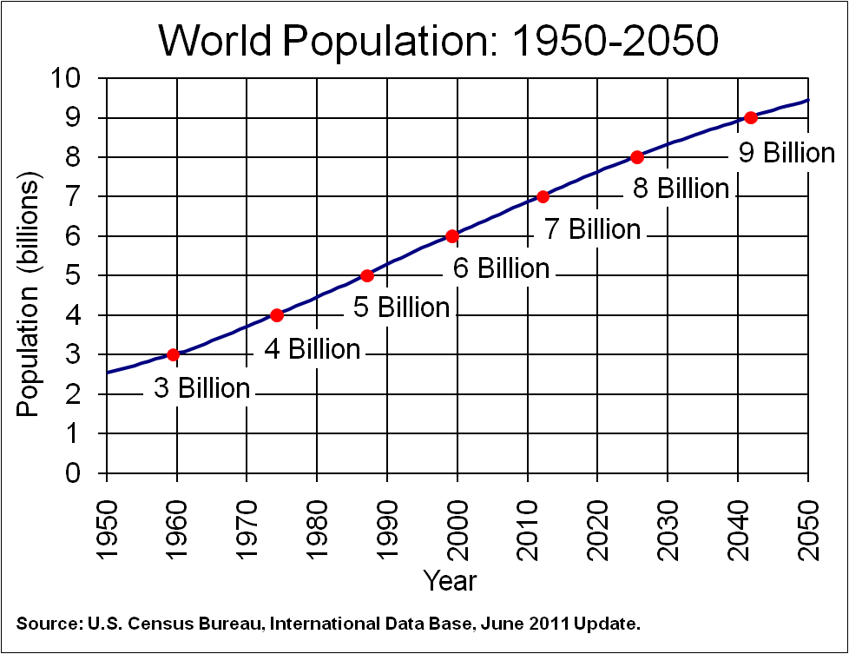
Increasing world population is driving huge increases in demand for seafood
(US Census, 2011)

Slide 4
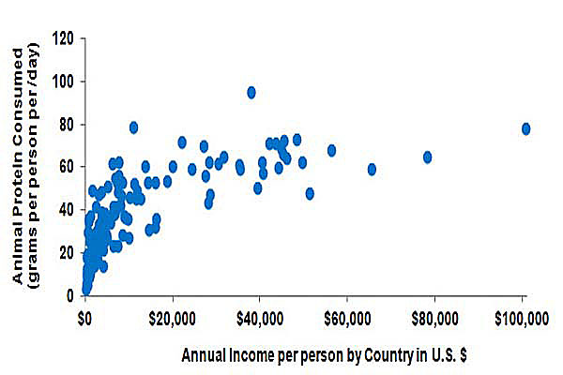
The demand for seafood is compounded by the increasing wealth and changing tastes of the worlds population
(USDA, 2004)

Slide 5
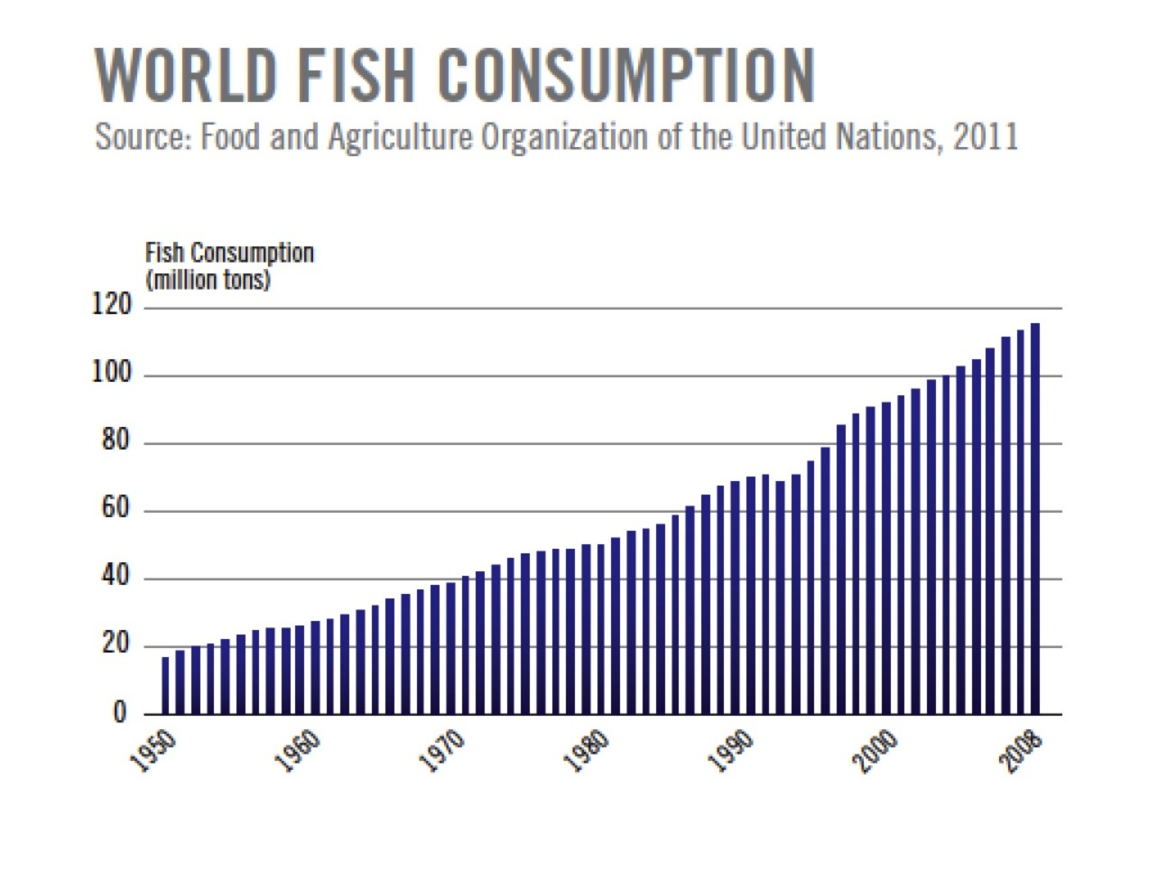
The result is that demand for seafood, especially fish, is rising steadily with no end in sight
(Source: UN FAO, 2011)

Slide 6
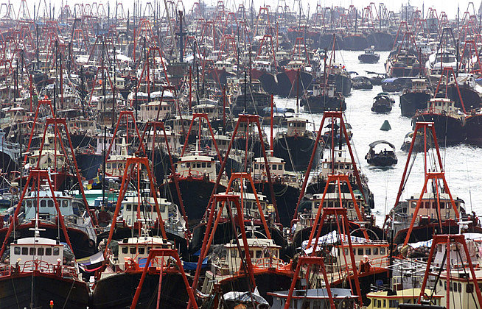
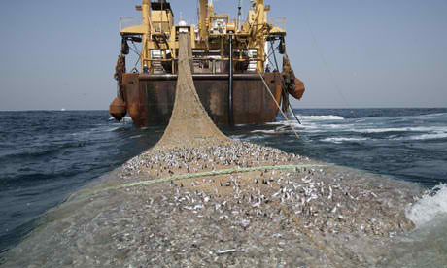
The fishing industry’s response?
… Larger fishing fleets and more aggressive nets
(Fishing Boat Fleet, 2014)
(Overfishing, 2013)

Slide 7
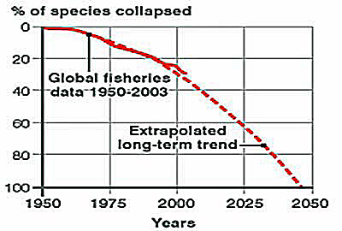
More fishing, less catching: overfishing is collapsing the world’s most important fisheries
(UN FAO, 2011a)

Slide 8
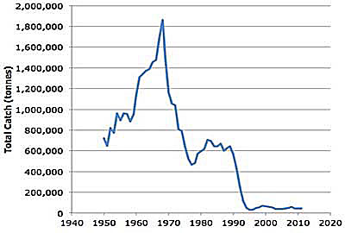
The Northwest Atlantic Cod provides a lesson of what can happen if we do not change the way we produce our seafood
Total catch of Northwest
Atlantic Cod by year
(UN FAO, 2012)

Slide 9
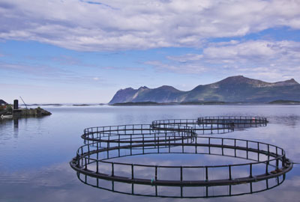
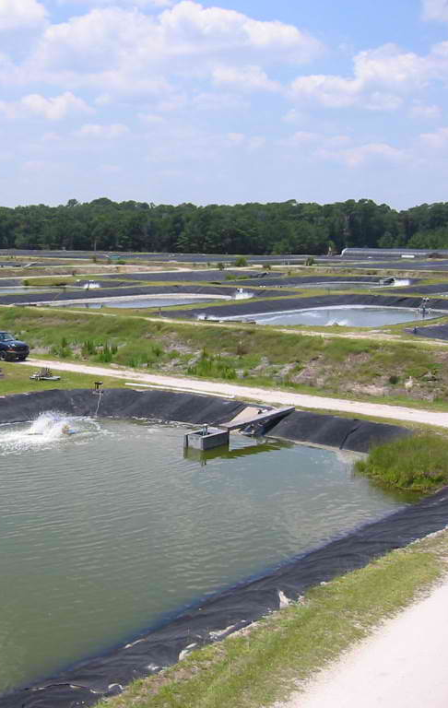
Aquiculture can provide one solution to overfishing in our open waters
Open Water Farms
Tanks
Ponds
(Environmental-watch, 2013)
(Local Ocean Fish Farm, 2010)
(Smith Pond Nursery , 2006)

Slide 10
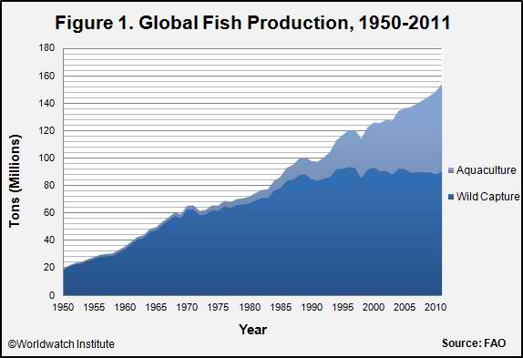
By adding 60 millions of seafood to the world’s supply annually, aquiculture is already helping reduce the pressure on open-water fisheries
Global Fish Production 1950 to 2011
(UN FAO, 2011)

Slide 11
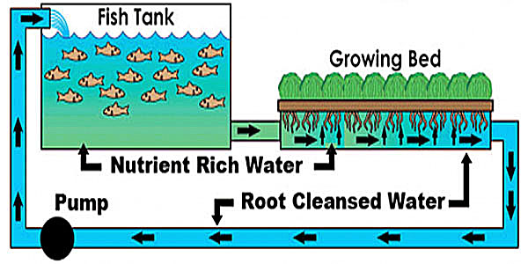
Ultimately, aquaponics the best solution is to producing seafood, producing both fish and plants in an environmentally friendly and sustainable way
(Tucson AquaPonics Project . 2013)

Slide 12
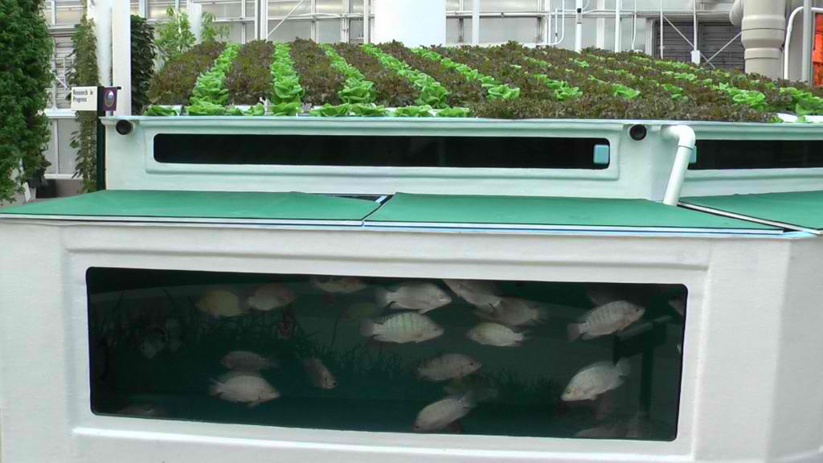
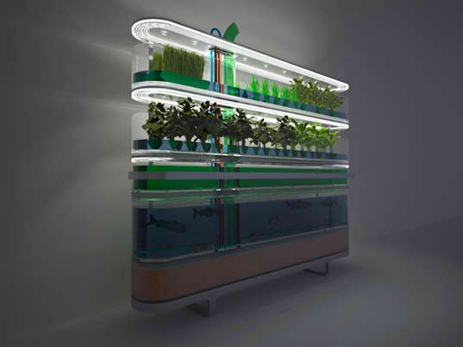
A wide variety of systems are being deployed to tailor aquaponics solutions to different environments
Industrial Scale
For The Individual
(EPCOT Aquaponics , 2012)
(Food Probe 6, 2014)

Slide 13
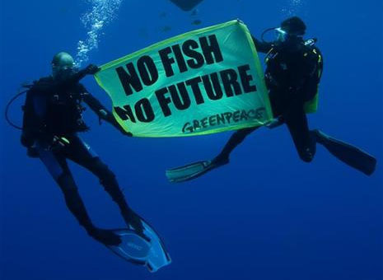
To save our open-water fisheries and feed the world, we must find a sustainable solution to fish production…..
Aquaculture and aquaponics
are the solution !
(Greenpeace USA. 2012)
(Local Ocean Fish Farm, 2010)

Slide 14
As the world’s population grows, traditional methods of fishing cannot meet the world’s demand for seafood.
Aquaculture and aquaponics are the solutions.
Joseph J. Grzyb
Johnson State College
ENV 4730
April 17, 2014
(Wallpaperswa, 2012)

Slide 15
Citations
Environmental-watch [Online Image]. (2013). Retrieved April 26, 2014 from
http://www.environmental-watch.com/2013/06/24/shellfish-sustainable-aquaculture.
EPCOT Aquaponics [Online Image]. (2012). Retrieved April 13, 2014 from
http://www.proaqua.com/images/epcot-aquaponics-1024x576.jpg.
Fishing Boat Fleet [Online Image]. (2014). Retrieved April 13, 2014 from https://encrypted-
tbn0.gstatic.com/images?q=tbn:ANd9GcQiWFjQ6Fhz6QjjvWtC9zhfiHZeq
51A78u2idsy6nr88NNnH7DD.
Food Probe 6 [Online Image]. Retrieved April 13, 2014 from http://www.inhabitat.com/wp-
content/uploads/foodprobe6.jpg.
Greenpeace USA. [Online Image]. (2012). No fish No Future. Retrieved April 28, 2014 from
https://www.flickr.com/photos/greenpeace_usa/7725610876/
Local Ocean Fish Farm. (2010). Aquaculture Tanks [Online Image]. Retrieved April 28, 2014 from
http://aquaculture210.blogspot.com/2010_12_01_archive.html.

Slide 16
Citations
Overfishing [Online Image]. (2013). Retrieved April 13, 2014 from http://crazycreatures.org/wp-
content/uploads/2013/01/Over-fishing.jpg
People [Online Image]. (2011). Retrieved April 13, 2014 from http://failingcivilization.com/wp-
content/uploads/2011/09/people.jpg
Smith Pond Nursery [Online Image]. (2006). Retrieved April 13, 2014 from
http://www.lib.noaa.gov/retiredsites/docaqua/nmaimages2006/smith_pond_nursery_wmc.jpeg
Tucson AquaPonics Project . (2013). What is Aquaponics? [Online Image]. Retrieved April 27, 2014
from http://www.tucsonap.org/sites/g/files/g292451/f/styles/large/public/
SystemDiagram.png?itok=ordN5jdn
UN FAO. (2011a). Fishchart [Online Image of Collapse of Fisheries]. Retrieved April 13, 2014
from http://maoctopus.files.wordpress.com/2011/01/fishchart.gif
UN FAO (2011). Global Fish production [Online Image]. Retrieved April 13, 2014 from
http://vitalsigns.worldwatch.org/sites/default/files/aquaculture_figure_1.jpg

Slide 17
Citations
UN FAO. (2011). World Fish Consumption [Online Image]. Retrieved April 13, 2014 from
https://encrypted-tbn2.gstatic.com/images?q=tbn:ANd9GcS4YTVAmKi7O7v5ibTw3wpYL-
auDIqt5Fn330isBuyhOrub_NGD
UN FAO. (2012). Northwest Atlantic Cod Production [Online Image]. Retrieved April 27, 2014 from
http://i863.photobucket.com/albums/ab195/weschenbach/
NorthwestAtlanticCodProduction_zpscd444397.jpg.
U.S. Census Bureau. (June 2011). World Population: 1950 – 2050 [Online Image]. Retrieved April 14,
2014 from http://www.census.gov/population/international/data/idb/images/worldpop.png
USDA. (2004). Protein Consumption vs Income [Online Image]. Retrieved April 13, 2014 from
http://images.engormix.com/e_articles/the-global-02.gif
World Wildlife Fund (2006). Industrial Fishing [Online Image]. Retrieved April 13, 2014 from
http://awsassets.panda.org/img/industrial_fishing_109842_384663.jpg
Wallpaperswa. (2012). [Online Image]. Water Ocean Fish Silhouette Wallpaper. Retrieved April 28,
2014 from http://wallpaperswa.com/Animals/Fish/water_ocean_
fish_silhouette_1920x1200_wallpaper_38555/download_2560x1600

