Slide 1
PowerPoint Animations and Style
The style is based on the Assertion-Evidence model presented
by Dr. Michael Alley.
Leslie Kanat

Slide 2
Use the Assertion-Evidence model.
http://writing.engr.psu.edu/assertion_evidence.html

Slide 3
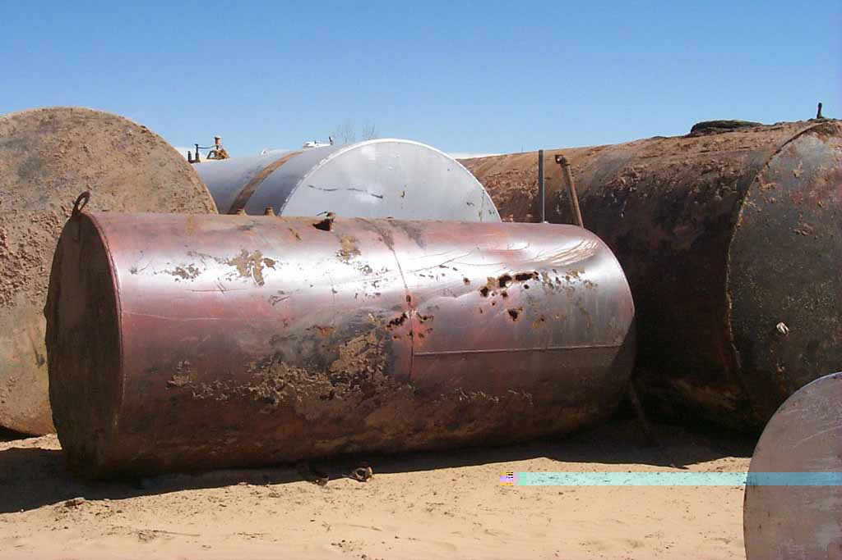
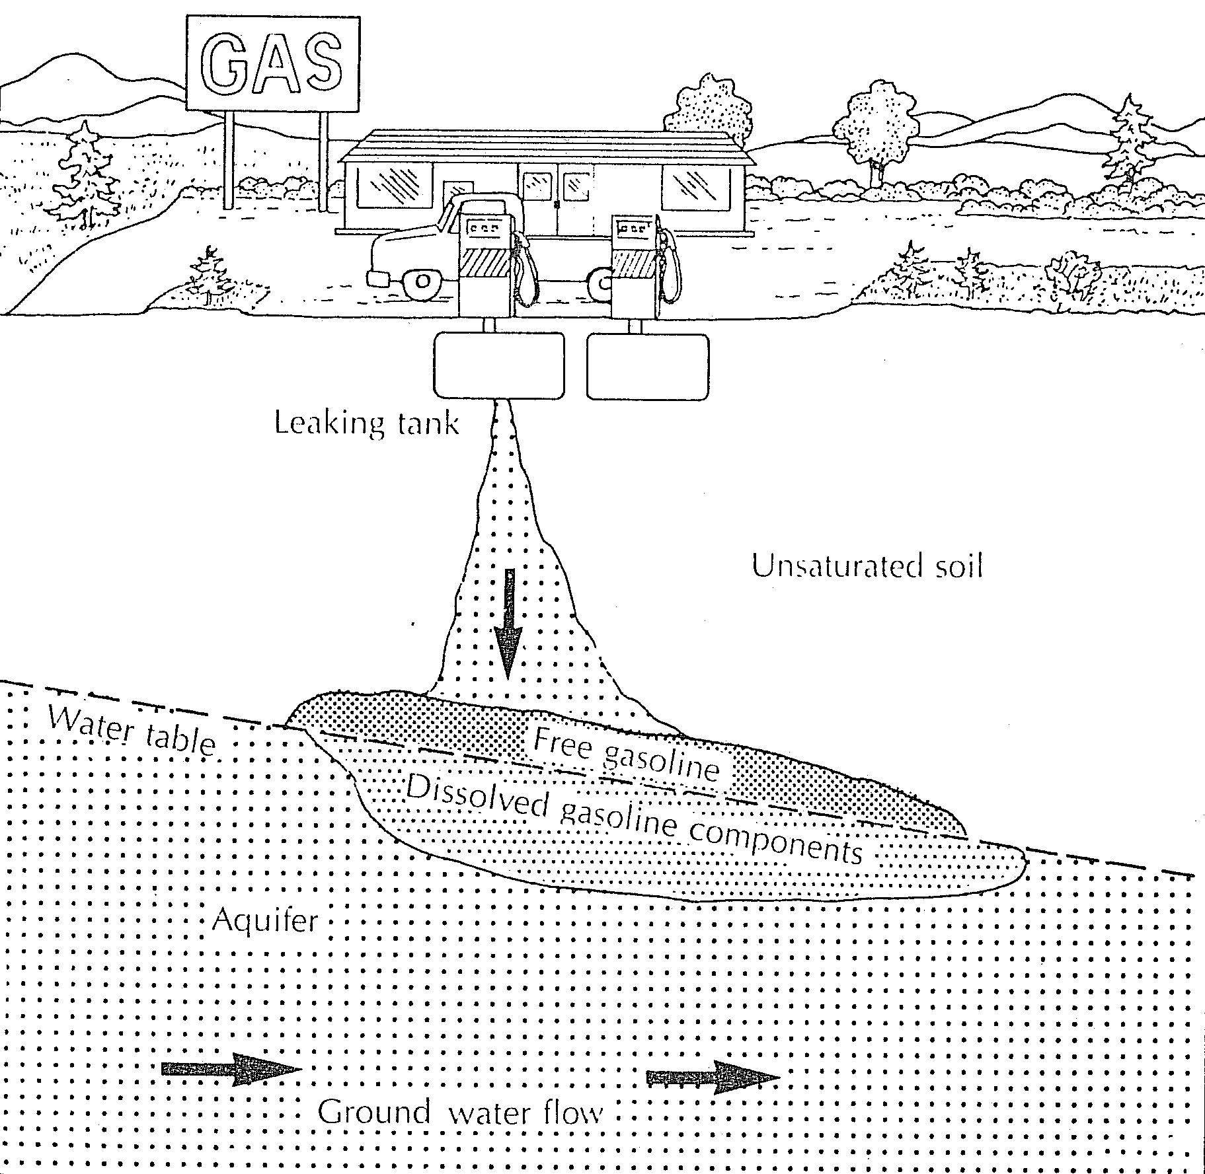
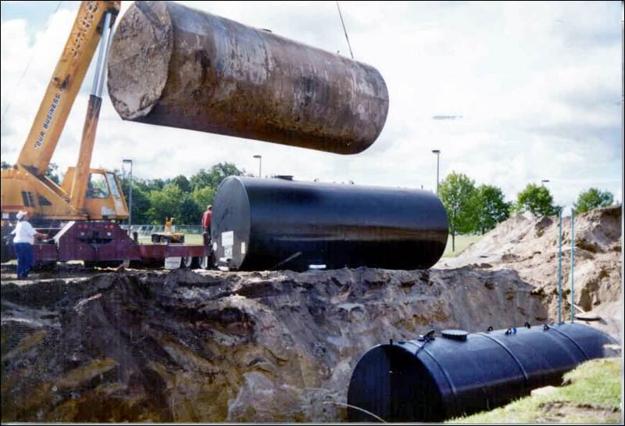
Many human activities produce toxic wastes that escape into the environment.
LUST
UST
http://www.bushman.cc
▼
▼
▼
▼
▼
http://www.toledoblade.com

Slide 4
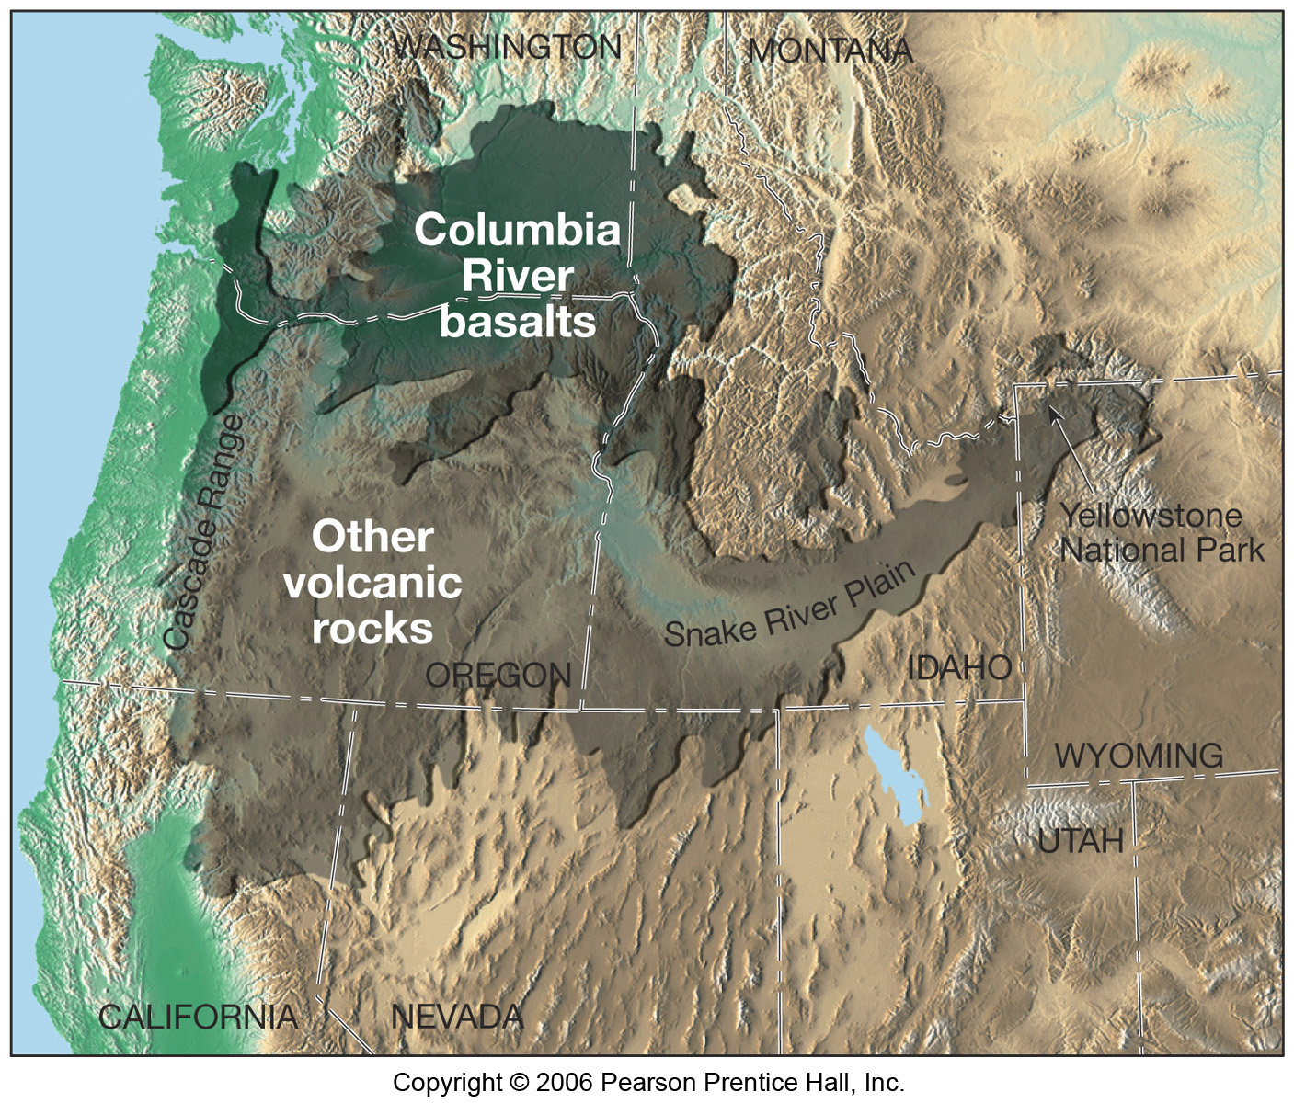
Low viscosity basaltic flows emanate from hot spots.

Slide 5
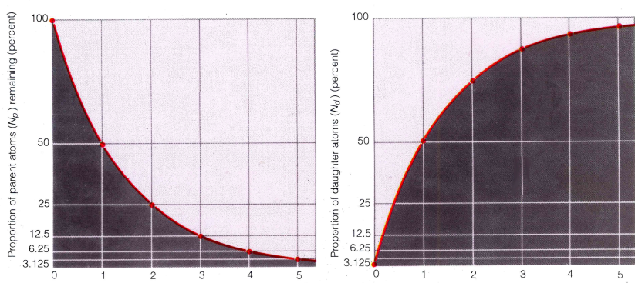
One-half of the parent isotope decays spontaneously to the daughter product in one half-life.
Decay of parent isotope
Percentage of parent isotopes remaining
Percentage of daughter isotopes produced
Growth of daughter product
Number of half-lives →
Number of half-lives →

Slide 6
In an expanding universe, all galaxies move away from each other.
past
future

Slide 7
Any galaxy could be the center.

Slide 8
Any galaxy could be the center, or there is no center.

Slide 9
A constant head permeameter allows for the calculation of hydraulic conductivity (K).
piezometers
nutrient
ΔH
waste
Q
Q
sample
ΔL
K =
A(∆H/∆L)
units of K are cm/s or g/d/ft²

Slide 10
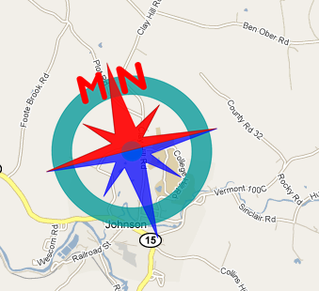
Declination is the horizontal angular difference between true (geographic) and magnetic north.
N
28 Feb 2015: Declination = 14° 47' W changing by 4.0' E per year.

Slide 11
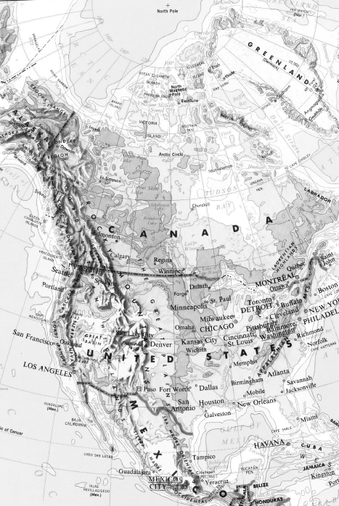
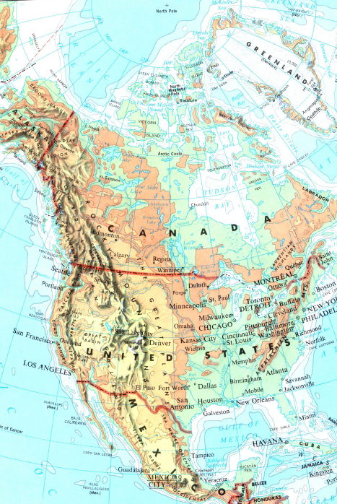
Declination is the angular difference between true and magnetic north.

Slide 12
Declination is the angular difference between true and magnetic north.

Slide 13
Declination is the angular difference between true and magnetic north.
15° W

Slide 14
Declination is the angular difference between true and magnetic north.
30° E
15° W

Slide 15
Declination is the angular difference between true and magnetic north.
30° E
15° W

Slide 16
Declination is the angular difference between true and magnetic north.
30° E
15° W

Slide 17
Declination is the angular difference between true and magnetic north.
30° E
3° W
declination model
determination

Slide 18
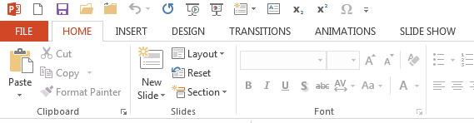
Customize the shortcut bar with: new, save, open, close, oops, redo, F5, shift-F5, new page, text box, subscript, superscript, and symbols.
F5 start from first slide
Shift-F5 start from current slide
new
save
open
close
oops
redo
new page
new text box
sub_{script}
super^{script}
symbols

Slide 19
Click the ‘customize’ button to modify the Quick Access Tool bar.

Slide 20
Modifications to graphics will highlight main points.
Use white background and dark text.
Use black line and shadow around images.
Use ‘animation pane’ and ‘add animation’ buttons.
Use ctrl-cursor when moving objects.
Use shift when sizing objects to maintain aspect ratio.
Use insert > shape > curve tool to outline objects; then double-click and use ‘edit shape’ for precision drawing.
Align one or more objects: format > align > center.
Use format painter tool for consistency.

Slide 21
Presentation shortcuts help tell the story.
To jump to a page, type the number, and hit enter; if really lost, tap ‘minus’ or ‘hyphen’.
Right arrow, enter, or spacebar to go forward.
Left arrow or backspace to go backward.
Know which objects start ‘after previous’.

