Slide 1
Fragile X Syndrome
Etiology of Behavior
Anxiety and Hyperarousal
Leslie and Lanie Kanat
Howard Center
August 2015
o

Slide 2
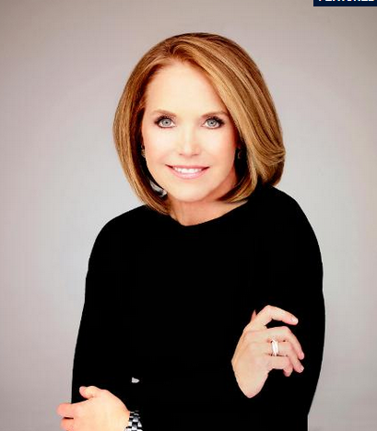
Katie Couric describes Fragile X Syndrome and its connection to autism.
http://news.yahoo.com/video/fragile-x-explained-010247619.html

Slide 3
Importance: to learn how to interact with those who have ASD associated with Fragile X Syndrome.
Importance: to learn how to interact with those who have ASD associated with Fragile X Syndrome.
o

Slide 4
If you know why,
you can figure out how.
− William Edward Deming
Management Consultant
o

Slide 5
Fragile X Syndrome
is a medical condition.
o

Slide 6
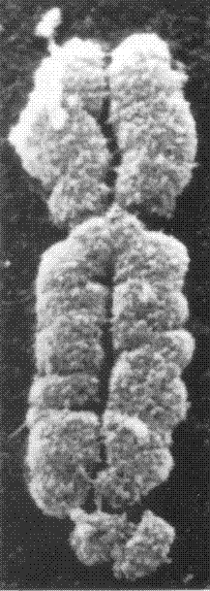
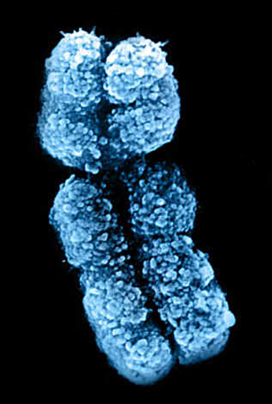
The name stems from the fact that the tip of the X chromosome looks like it might break.
Fragile X
Typical X
Y

Slide 7
Fragile X Syndrome
is a single gene disorder.
FMR1 → FMRP

Slide 8
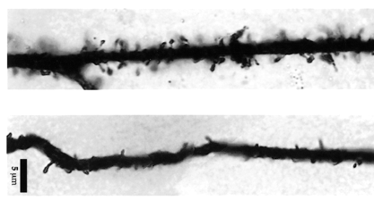
The lack of FMRP results in long dendritic spines, increased spine density, high neurotransmitter activation, and failure of the synapse maturation
and pruning processes.
Dendrite from a human afflicted by FXS.
5 ɥm
Dendrite from unaffected human.
o
http://cercor.oxfordjournals.org/content/10/10/1038.long

Slide 9
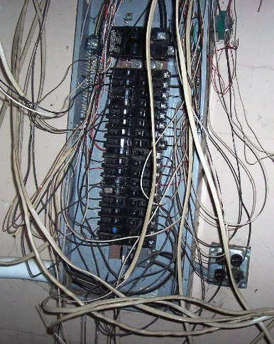
Antiquated fuse box that can not handle any more input − too many connections going everywhere.
http://www.youshouldown.com/img/homeins/panel2.jpg

Slide 10
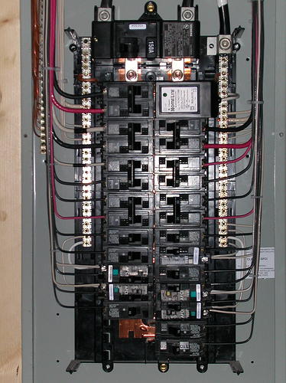
Because we can not rewire the brain, we have to make accommodations for the poor wiring.
http://roncoelectricnj.com/files/2014/05/electricalpanel1.jpeg

Slide 11
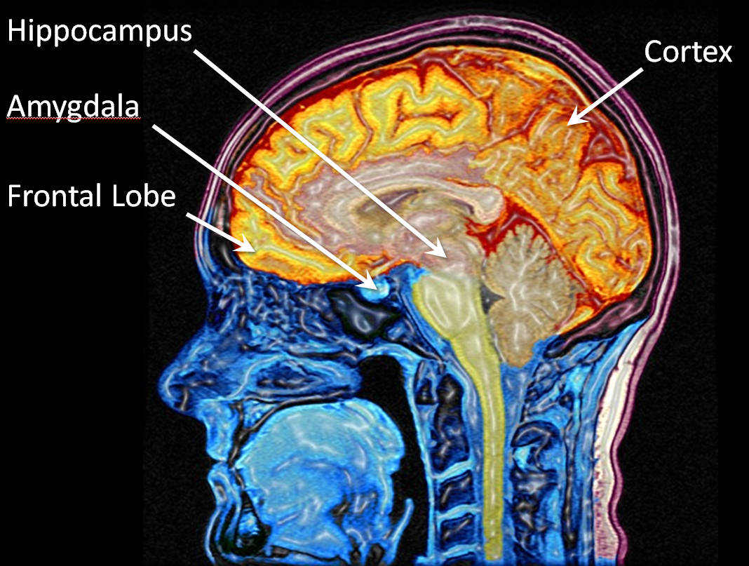
The lack of FMRP results in an overabundance of improper and overactive neuronal connections.
≈60% have ASD
≈20% have seizures

Slide 12
The lack of FMRP results in an overabundance of improper brain connections.
Strengthened in the amygdala: anxiety.
Weakened in the cortex and hippocampus: short-term memory.
Weakened in the frontal lobe: hyperactivity and executive function.

Slide 13
You can’t battle biology.
– Dr. Karen Riley
One can’t treat behaviors without accounting for the neurobiology.

Slide 14
Etiology of the behavior is rooted in the neurobiology of Fragile X Syndrome.
Anxiety.
Speech and language delays.
Gross and fine motor delays.
Sensory integration dysfunction.
Physical issues.
Cognitive deficits.
Run away, drop to the floor,
chew on items, or scratch;
fear, fight or flight response.
He cries, is remorseful, apologetic, and it’s over.
Generates a response from a teacher, therapist, or parent.

Slide 15
Hyperconnectivity in the amygdala, and an underactive GABA inhibitory system, result in anxiety and hyperarousal.
overstimulation
sensory
break
sensory
break
Hyperarousal Level →
sensory
break
Time →
o

Slide 16
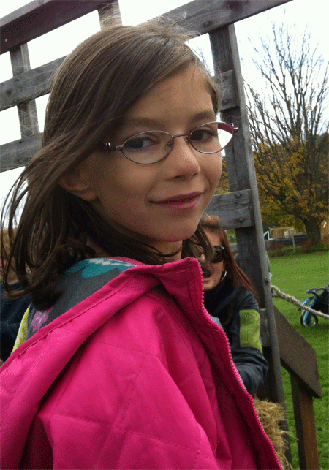
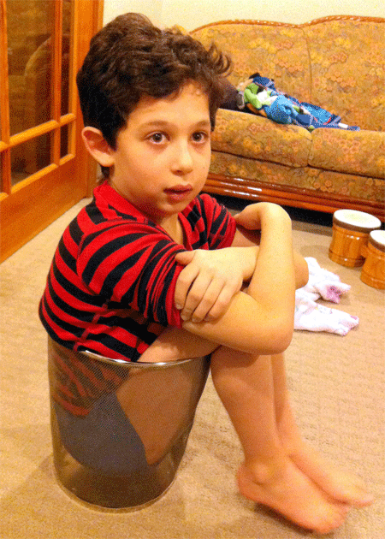
Marin was asked: “How do you deal with Ryan when he gets over excited?” Her response: “I just wait.”
Marin
Ryan

Slide 17
The important issues in Fragile X Syndrome are hyperarousal and intellectual function.
Hyperarousal intervention strategies appear opposite in practice to the nature
of many autism intervention strategies.
o

Slide 18

  Those with FXS are incidental learners who easily become overwhelmed in the face of direct instruction.
http://dataworks-ed.com/wp-content/uploads/2014/06/EDI.jpg

Slide 19
  Those with FXS are incidental learners who easily become overwhelmed in the face of direct instruction.
It is critical to modify discrete
timed trials, and avoid face-to-face interactions and forced responses.
o

Slide 20
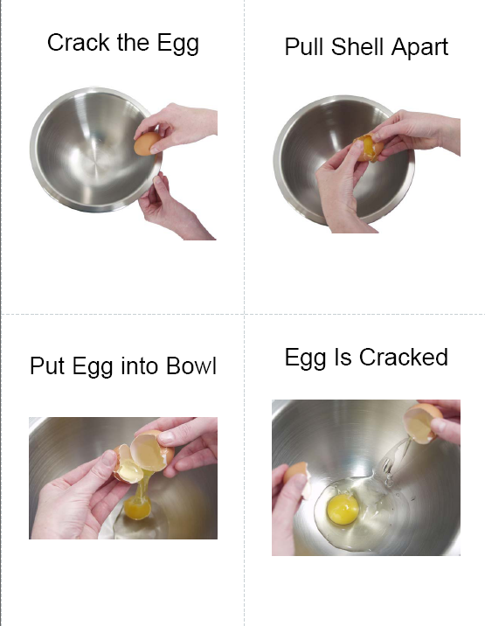
Autism intervention programs often use sequential teaching, especially forward chaining methods, yet is directly counter to the FXS learning style.
http://www.iloveaba.com/2013/09/backward-forward-chaining.html

Slide 21
Autism intervention programs often use sequential teaching, especially forward chaining methods, yet is directly counter to the FXS learning style.
Children with FXS are simultaneous learners. They are gestalt learners who need to see the end product. They can replicate through imitation.

Slide 22
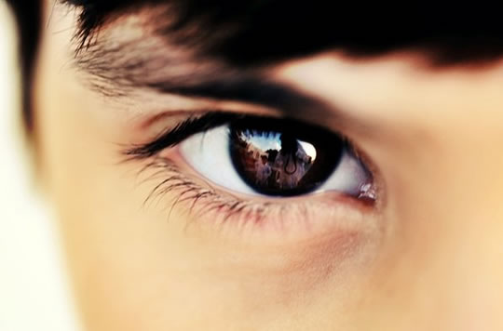
Autism intervention programs target social skills, including eye contact and social interaction, with reinforcement for correct performance.
http://cdn-media-1.lifehack.org/wp-content/files/2014/06/Eye-Contact.jpg

Slide 23
Autism intervention programs target social skills, including eye contact and social interaction, with reinforcement for correct performance.
When those with FXS feel social pressure, their hyperarousal skyrockets, and the social skills are sacrificed.
o

Slide 24
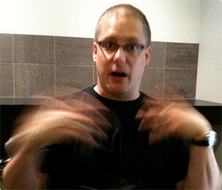
Autism intervention programs target atypical behaviors (such as perseverative speech, hand flapping and biting) and attempt to modify them.
http://www.handresearch.com/diagnostics/mental-disorders/hand-flapping.jpg

Slide 25
Autism intervention programs target atypical behaviors (such as perseverative speech, hand flapping and biting) and attempt to modify them.
For those with FXS it is better to proactively reduce hyperarousal rather than struggle to change behaviors.

Slide 26
  For those with autism associated with Fragile X Syndrome, it is the FXS learning style that is first and foremost, so reducing hyperarousal should lead the way for all interventions.
o

Slide 27
ABA is highly structured, yet those with FXS need highly flexible interventions.
Antecedent may have occurred days prior to the maladaptive behavior, or it could be a scheduled future event.
Discrete trials do not often provide best evidence for those with FXS.
Wait to reduce anxiety.

Slide 28
ABA is also highly variable in its delivery.
Dr. Marcia Braden has shown that Pivotal Response Training (PRT) and Strategies for Teaching based on Autism Research (STAR) can work with those who have FXS.

Slide 29
Individuals with FXS fall somewhere on the DSM-5 for autism.
Enthusiastic
Fun-loving
Loving
Gentle
Happy
Distractible
Easily redirected
Good imitators
As long as their hyperarousal levels are low.

Slide 30
People with autism and FXS display a wide range of individual characteristics.
People with autism and FXS display a wide range of individual characteristics.
Autism Spectrum Disorders Fragile X Syndrome
Social indifference Social anxiety
Gaze indifference Gaze aversion
Appear socially passive Generally friendly
Variable language delays Language delays
Poor understanding Understand facial
of facial expressions expressions
Variable intellectual abilities Cognitive delays
o

Slide 31
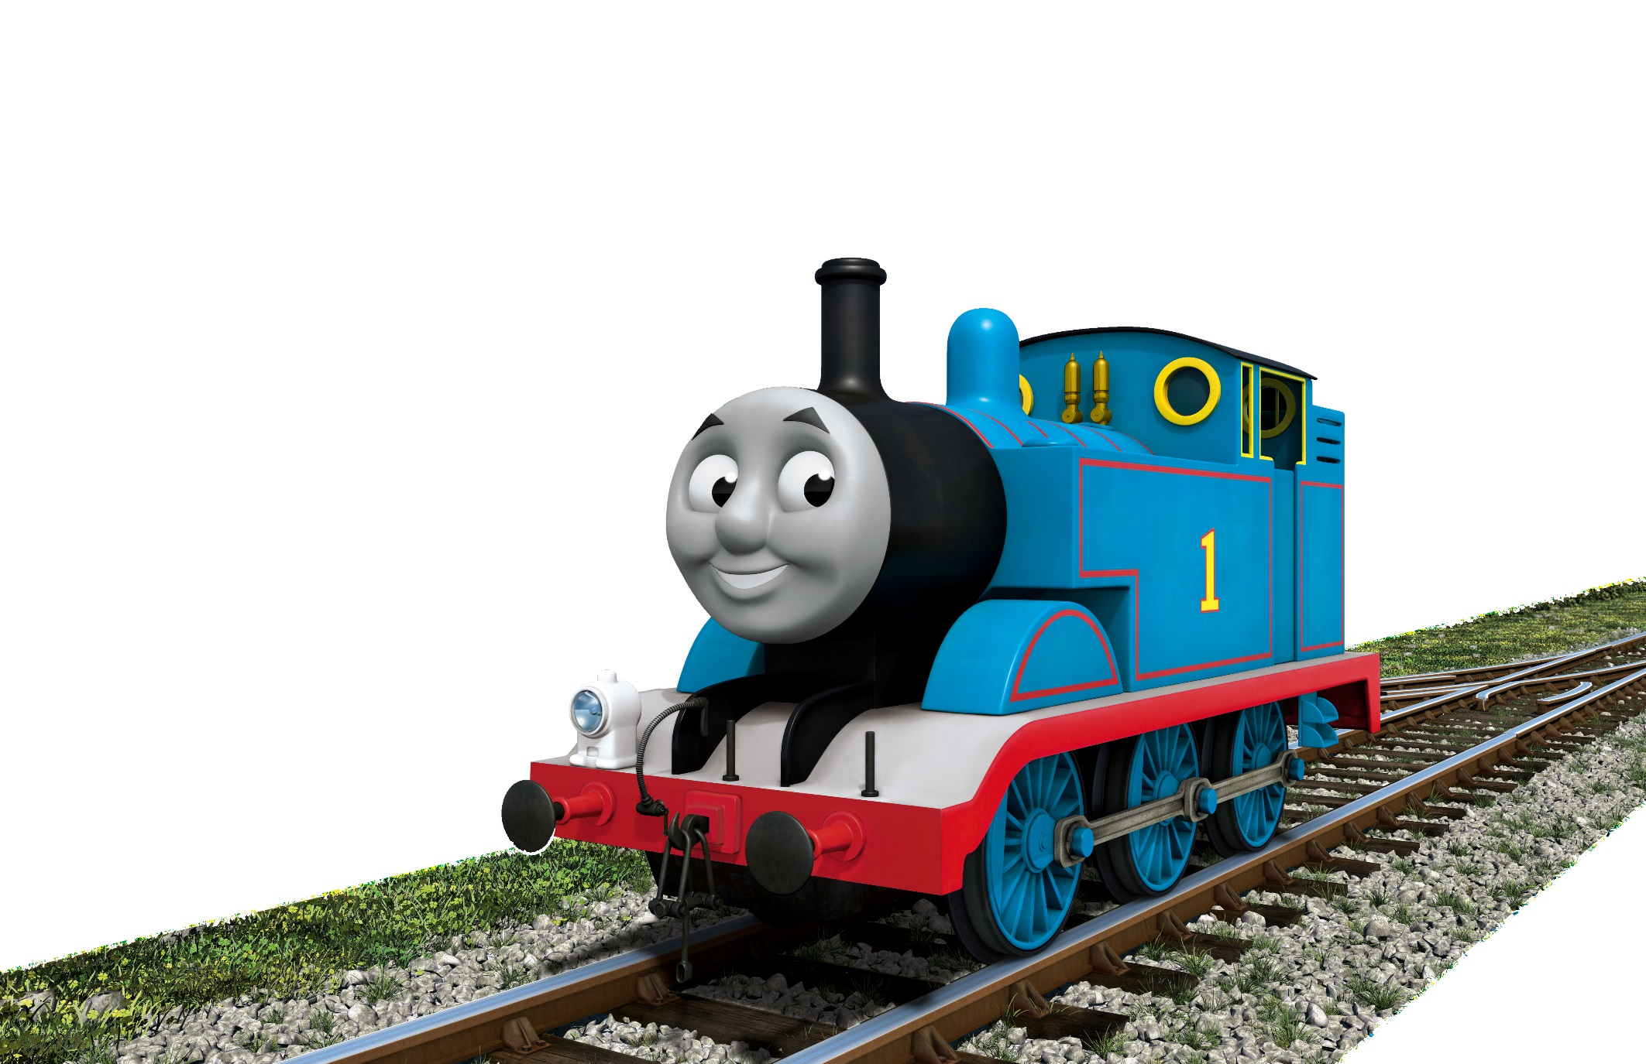
Thomas the Tank Engine is favored because facial expressions and directions do not change.

Slide 32
Etiology of the behavior is rooted in the neurobiology of Fragile X Syndrome.
Impulsive
Hyperactive
Social anxiety
Cognitive delays
Attention deficit disorders
Ritualistic and repetitive behaviors
A fear, fight or flight response

Slide 33
Etiology of the behavior is rooted in the neurobiology of Fragile X Syndrome.
These kids want to be normal,
yet they know they are not.
They want to please.
Threats and coercion do not work.
They understand failure − perceived as a threat resulting in anxiety.

Slide 34
Etiology of the behavior is rooted in the neurobiology of Fragile X Syndrome and therefore individuals are challenged by:
Changes in routine
Forced responses
New situations
Transitions
Large crowds
Social situations
Personal boundaries

Slide 35
The FXS learning styles have been well documented in the literature.
Use visual cues (not verbal cues).
Stay neutral (and positive).
Avoid direct eye contact.
Provide two choices.
Find a hook to make a connection.
These techniques will help reduce anxiety.

Slide 36
The FXS learning styles have been well documented in the literature.
Uncanny social drive.
Developed sense of humor.
Strong memory for routine.
Require greater organization.
Imitate behaviors and mannerisms.
Follow the schedule, not the clock.

Slide 37
The FXS learning styles have been well documented in the literature.
Simultaneous learners (not sequential).
Gestalt learners (show final product).
Cloze technique (backwards chaining).
Incidental learners (he is attending).
Indirect instruction (involvement).
Side dialogues (a conversation).
Peer and video modeling.
Self-talk.

Slide 38
The main problem with many autism intervention programs is that they fail to take into consideration the learning styles of individuals with FXS in which the main issue is hyperarousal.

Slide 39
The goal is to keep hyperarousal low.
Use calm, simple, caveman language.
Acknowledge appropriate behavior.
Once you promise it, deliver it.
There is a need for closure.
When successful, do not ask for more, even if requested.

Slide 40
The goal is to keep hyperarousal low.
Calming behaviors (self-regulation)
Sensory diet (build in breaks)
Speech and language therapy
Occupational therapy
Deep pressure activity
Music and song

Slide 41
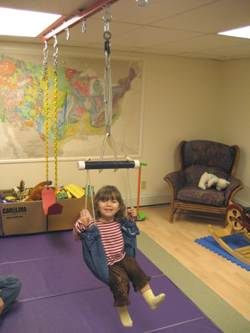
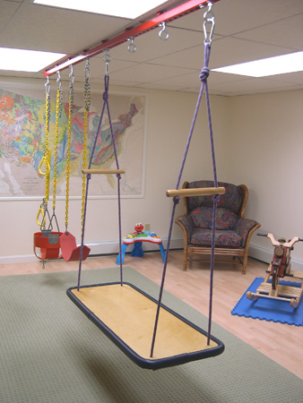
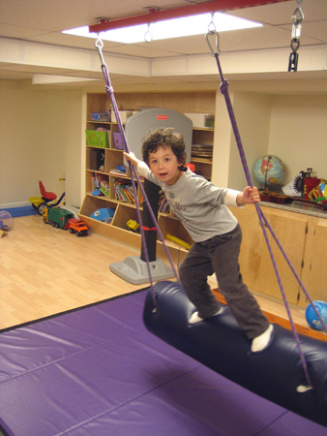
Occupational therapy helps provide proprioceptive input.
frog swing
platform swing
bolster swing, net
and balance beam
http://kanat.jsc.vsc.edu/ot/

Slide 42
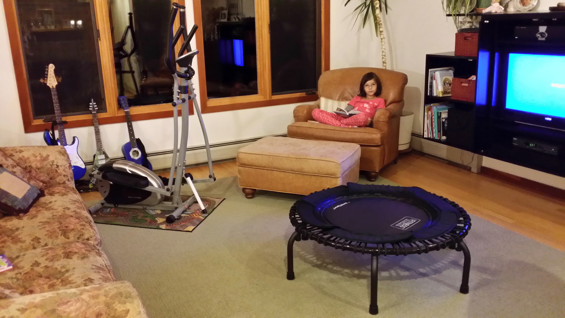
Occupational therapy helps provide proprioceptive input.
guitars
elliptical
trampoline

Slide 43
Numerous accommodations in place at home.
Continuous bathroom reminders.
Exterior doors locked from inside.
Cabinets are locked.
He is never left alone.
DVD and iPad are priceless.
Everything is planned − schedules.

Slide 44
What are our goals for his future?
To find ways to reduce his anxiety.
Recognize when he is becoming overstimulated and to self-regulate.
Develop basic living skills
(simple hygiene, communication, social skills, and quantitative skills).
Find a place for him to live where
he will be safe.

Slide 45
Your challenge: identify those who have ASD associated with Fragile X Syndrome, and adapt the ABA approach to accommodate Fragile X learning styles.

Slide 46


les.kanat@jsc.edu
lanie.kanat@comcast.net
fragilex.org
northernvt.fragilex.org
fb.me/fragilexvt

Slide 47




fraxa.org
1864
morgridge.du.edu/staff-members/riley-karen-s-phd
Morgridge College of Education
marciabraden.com
developmentalfx.org

Slide 48
Live the Fragile X way.
Be proactive, no surprises, have accommodations in place, model appropriate behavior, and remain calm.

